Slide 1
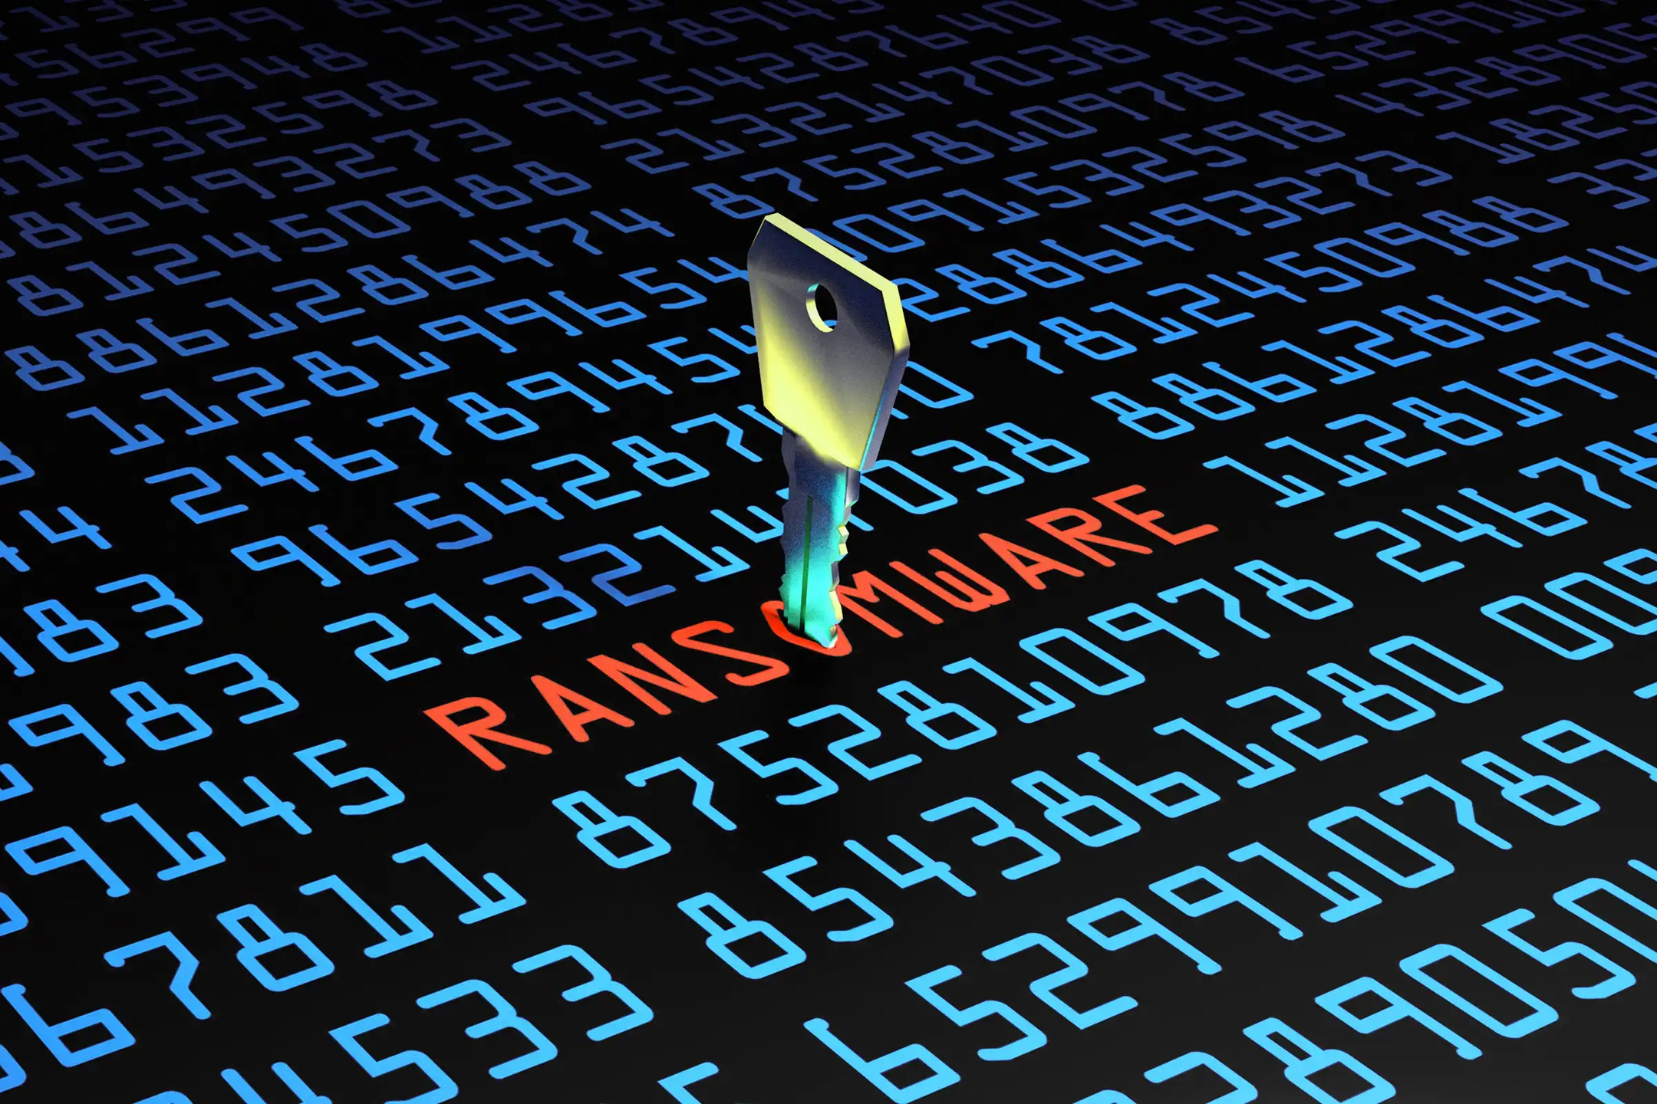
Created by: Alem Borcak

Slide 2
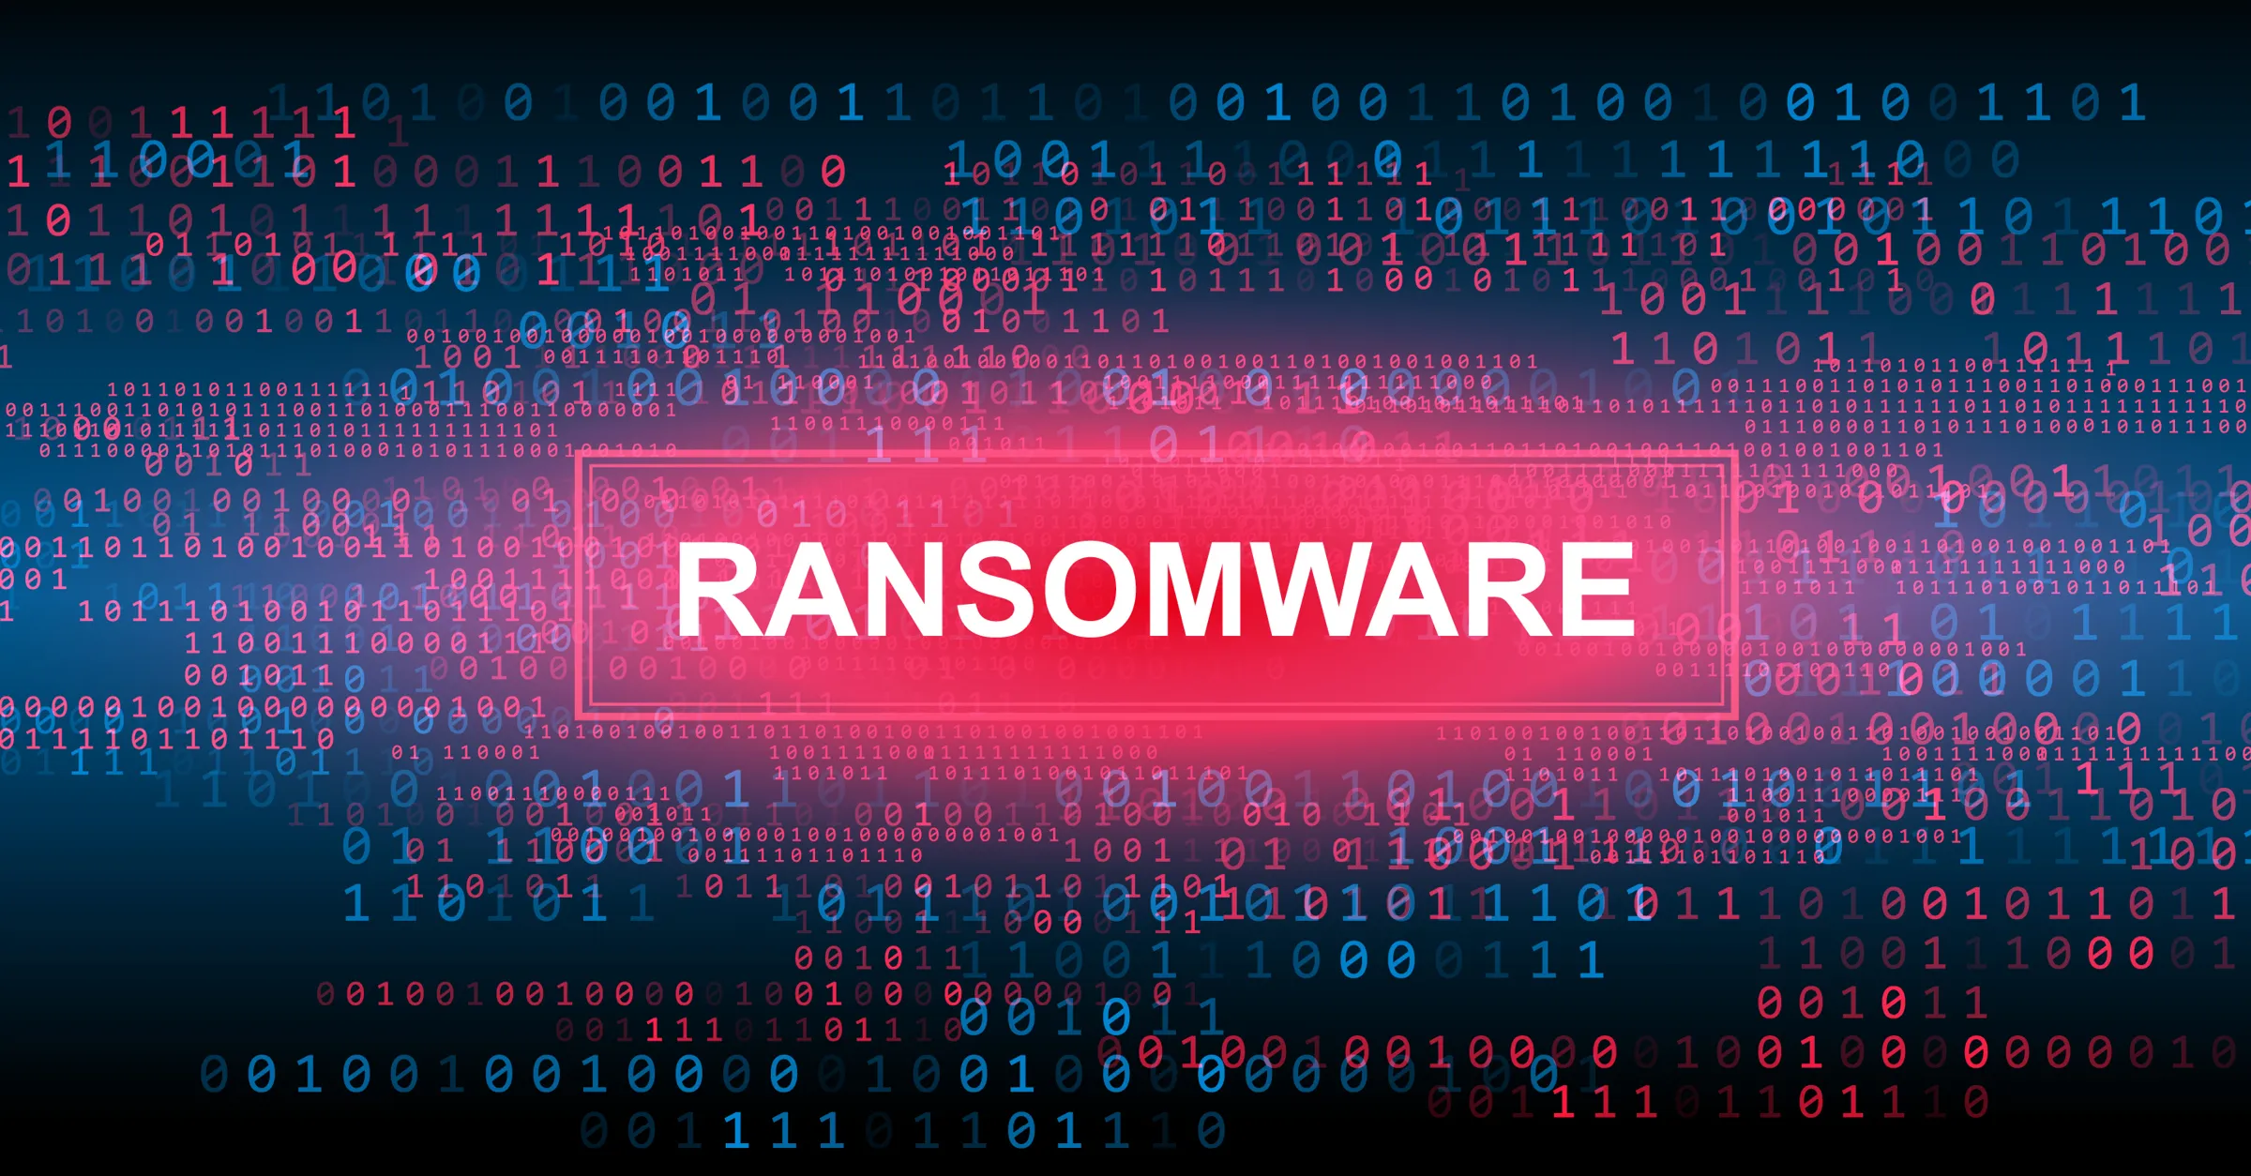
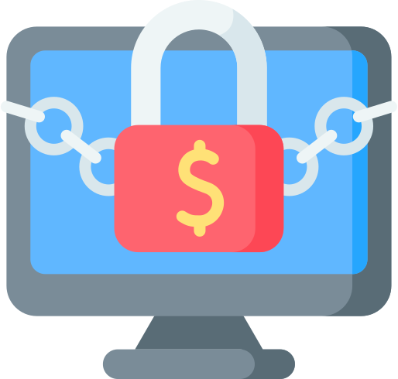
~Introduction~
Definition: Malicious software designed to encrypt files or lock users out of their systems until a ransom is paid.
Rapidly growing cyber threat: Ransomware attacks have become increasingly common and sophisticated.
Impact on individuals and organizations: From personal files to large enterprises, no one is immune to ransomware attacks.
Financial motivations: Attackers seek financial gain through ransom payments, often demanding payment in cryptocurrency to remain anonymous.

Slide 3



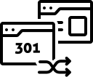

--Common Attacks--
Phishing Emails: Attackers often use email attachments or links to distribute ransomware.
Exploit Kits: Leveraging vulnerabilities in software or operating systems to install ransomware.
Remote Desktop Protocol (RDP): Brute-forcing or exploiting weak RDP credentials to gain access.
Drive-by Downloads: Malicious code is silently downloaded onto the victim's system when visiting compromised websites.
Malvertising: Malicious advertisements on legitimate websites redirect users to sites hosting ransomware.

Slide 4
$Encryption$
Encryption Process: Ransomware encrypts files using strong encryption algorithms, rendering them inaccessible without the decryption key.
Ransom Demands: Attackers demand payment in cryptocurrency, typically Bitcoin, in exchange for the decryption key.
Time Pressure: Attackers impose deadlines for ransom payment, often accompanied by threats of permanent data loss or increased ransom amounts.

Slide 5

WannaCry
Notorious ransomware: WannaCry gained infamy for its widespread and devastating impact in 2017.
Unprecedented scale: WannaCry infected hundreds of thousands of computers across 150 countries within days of its emergence.
Exploited EternalBlue vulnerability: Leveraged a Windows SMB vulnerability to propagate rapidly across networks.
Alleged North Korean involvement: WannaCry was attributed to the Lazarus Group, a cybercrime organization linked to North Korea.

Slide 6
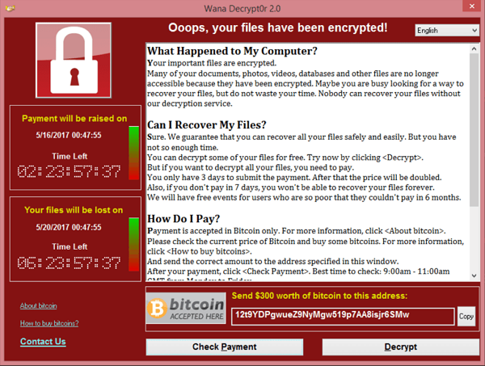

Slide 7
WannaCry
Initial infection vector: WannaCry primarily spread through phishing emails containing malicious attachments or links.
Worm-like behavior: Exploited EternalBlue vulnerability to self-propagate within networks, infecting connected devices.
Targeted critical infrastructure: Affected healthcare systems, government agencies, financial institutions, and businesses worldwide.
Global economic impact: Estimated financial losses in the billions of dollars, including ransom payments, recovery costs, and productivity losses.

Slide 8
WannaCry
File encryption: WannaCry encrypted files on infected systems, rendering them inaccessible without the decryption key.
Bitcoin payments: Victims were instructed to pay ransom in Bitcoin to receive decryption keys, with payment deadlines to escalate urgency.
Varied ransom amounts: Initial ransom demands ranged from a few hundred to several thousand dollars, with increased amounts for delayed payments.
No guarantee of decryption: Paying the ransom did not guarantee decryption, as some victims reported receiving no response or decryption keys.

